Slide 1

AN ULTRA LOW POWER 10 TRANSISTOR 1 BIT MAGNITUDE COMPARATOR USING GATE DIFFUSION INPUT TECHNIQUE
Shahrear Hossain Shawon
ID: ET223104
Supervised by:
Riazul Islam
Lecturer
Department of
Electrical and Electronic Engineering
INTERNATIONAL ISLAMIC UNIVERSITY CHITTAGONG

Slide 2
INTRODUCTION
PROBLEM STATEMENT
OBJECTIVES
Table of Contents
METHODOLOGY
LITERATURE REVIEW
INTRODUCTION TO COMPARATOR
CMOS LOGIC STYLES
CIRCUIT DESIGN COMPARE IN VARIOUS TECHNIQUE
01

Slide 3
GATE DIFFUSION INPUT (GDI) TECHNIQUE
PROPOSED 10 TRANSISTOR GDI MAGNITUDE COMPARATOR
Table of Contents
SIMULATION RESULTS
PERFORMANCE COMPARISON
CONCLUSION
FUTURE WORK
02

Slide 4
INTRODUCTION
Magnitude comparators are fundamental building blocks in digital VLSI systems, used to compare two binary inputs and determine A greater than B, A less than B, or A equal to B.
They play a crucial role in arithmetic logic units (ALUs), processors, memory address decoding, digital controllers, and embedded systems.
The growing demand for ultra-low-power and high-speed integrated circuits has increased the need for comparator designs with lower transistor count, reduced power consumption, and faster propagation delay
This thesis proposes and analyzes an Ultra-Low-Power 10-Transistor 1-Bit Magnitude Comparator using the Gate Diffusion Input (GDI) Technique, and evaluates its performance in terms of power, propagation delay, and power-delay product (PDP) across 180 nm, 90 nm, and 45 nm PTM technology nodes.Select 52 more words to run Humanizer.
.
03

Slide 5
PROBLEM STATEMENT
High transistor count in conventional CMOS comparators.
Increased power consumption and silicon area.
Higher propagation delay due to complex logic paths.
Leakage current and parasitic capacitance at scaled technology nodes.
Need for an ultra-low-power, high-speed comparator design.
GDI technique offers reduced transistor count and improved efficiency.
Comparative evaluation is required using Power, Delay, PDP, and Transistor Count.
04

Slide 6
OBJECTIVES
01
To design and simulate 1 Bit Comparator using CMOS GDI technique.
02
Reduce Transistor Number of the Comparator
03
To evaluate and compare key performance parameters such as:
Rise time, Fall time, Propagation delay, Power consumption. PDP
05

Slide 7
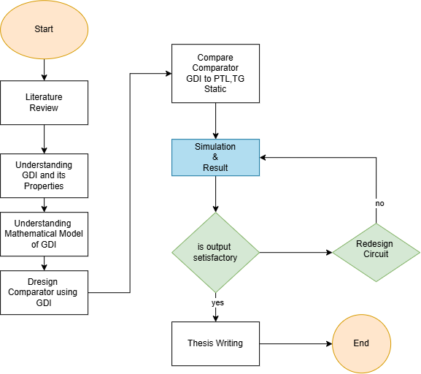
METHODOLOGY
06

Slide 8
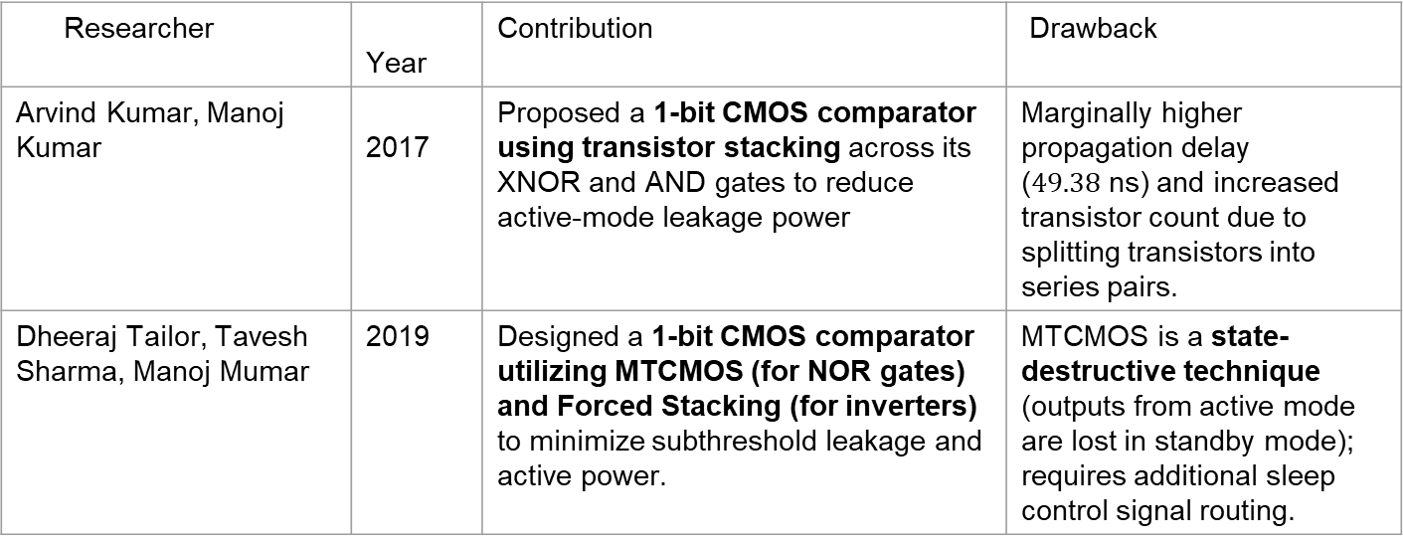
LITERATURE REVIEW
Researcher | Year | Contribution | Drawback
Arvind Kumar, Manoj Kumar | 2017 | Proposed a 1-bit CMOS comparator using transistor stacking across its XNOR and AND gates to reduce active-mode leakage power | Marginally higher propagation delay ($49.38\text{ ns}$) and increased transistor count due to splitting transistors into series pairs.
Dheeraj Tailor, Tavesh Sharma, Manoj Mumar | 2019 | Designed a 1-bit CMOS comparator utilizing MTCMOS (for NOR gates) and Forced Stacking (for inverters) to minimize subthreshold leakage and active power. | MTCMOS is a state-destructive technique (outputs from active mode are lost in standby mode); requires additional sleep control signal routing.
07

Slide 9
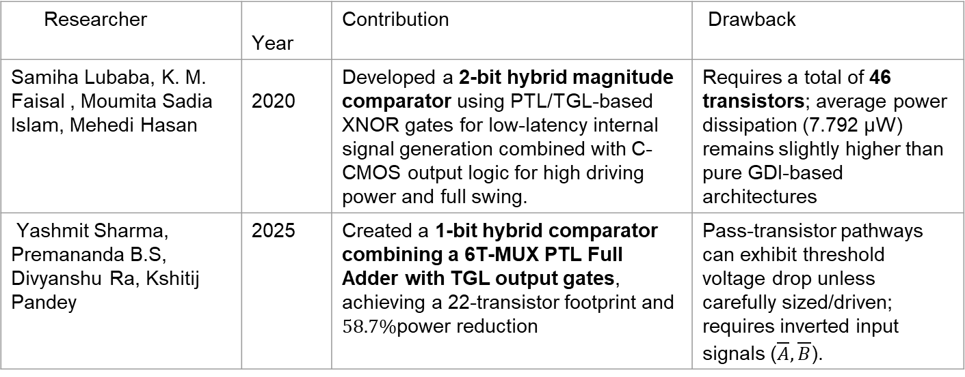
LITERATURE REVIEW
Researcher | Year | Contribution | Drawback
Samiha Lubaba, K. M. Faisal , Moumita Sadia Islam, Mehedi Hasan | 2020 | Developed a 2-bit hybrid magnitude comparator using PTL/TGL-based XNOR gates for low-latency internal signal generation combined with C-CMOS output logic for high driving power and full swing. | Requires a total of 46 transistors; average power dissipation (7.792 µW) remains slightly higher than pure GDI-based architectures
Yashmit Sharma, Premananda B.S, Divyanshu Ra, Kshitij Pandey | 2025 | Created a 1-bit hybrid comparator combining a 6T-MUX PTL Full Adder with TGL output gates, achieving a 22-transistor footprint and $58.7\%$power reduction | Pass-transistor pathways can exhibit threshold voltage drop unless carefully sized/driven; requires inverted input signals ($\overline{A},\overline{B}$).
08

Slide 10
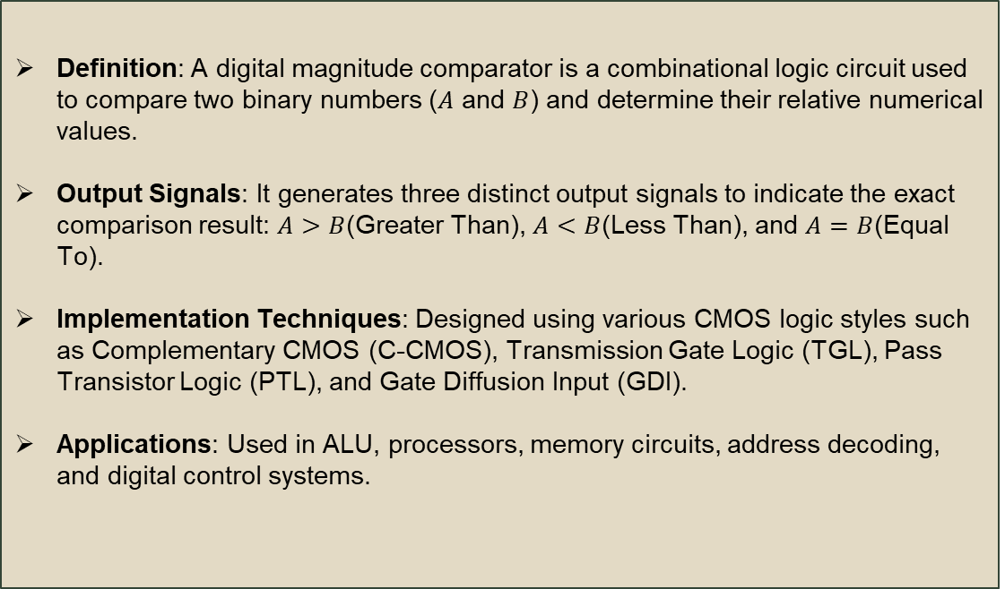
INTRODUCTION TO Comparator
Definition: A digital magnitude comparator is a combinational logic circuit used to compare two binary numbers ($A$ and $B$) and determine their relative numerical values.
Output Signals: It generates three distinct output signals to indicate the exact comparison result: $A>B$(Greater Than), $A<B$(Less Than), and $A=B$(Equal To).
Implementation Techniques: Designed using various CMOS logic styles such as Complementary CMOS (C-CMOS), Transmission Gate Logic (TGL), Pass Transistor Logic (PTL), and Gate Diffusion Input (GDI).
Applications: Used in ALU, processors, memory circuits, address decoding, and digital control systems.
09

Slide 11
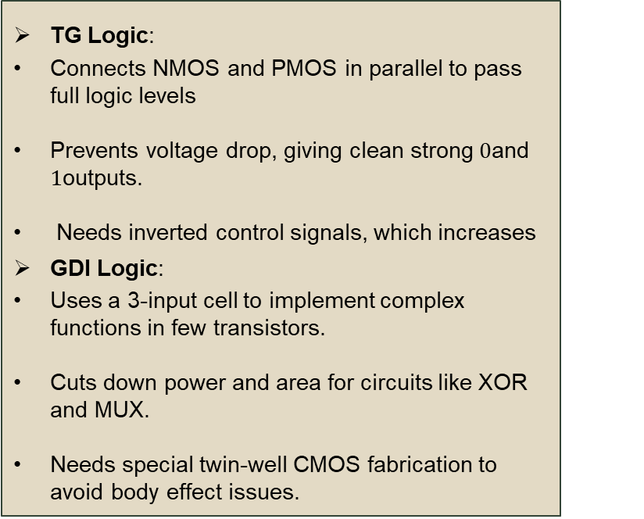
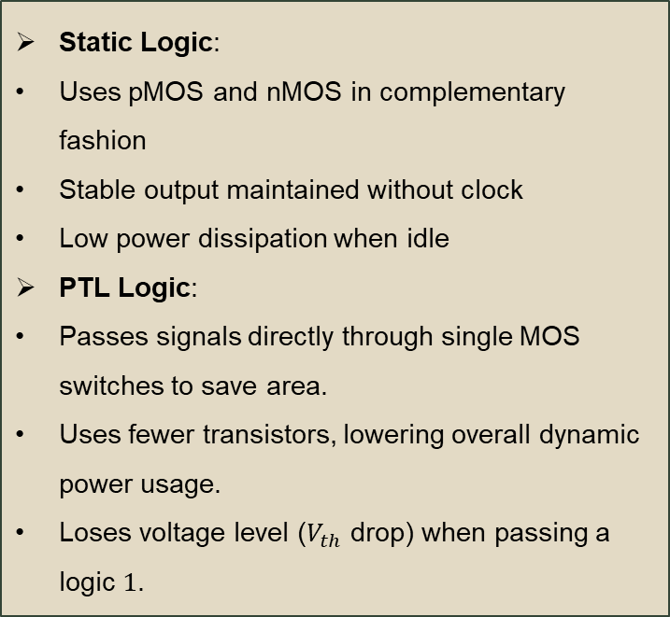
CMOS Logic Styles
Static Logic:
  Uses pMOS and nMOS in complementary fashion
  Stable output maintained without clock
  Low power dissipation when idle
PTL Logic:
  Passes signals directly through single MOS switches to save area.
  Uses fewer transistors, lowering overall dynamic power usage.
  Loses voltage level ($V_{th}$ drop) when passing a logic $1$.
TG Logic:
  Connects NMOS and PMOS in parallel to pass full logic levels
  Prevents voltage drop, giving clean strong $0$and $1$outputs.
  Needs inverted control signals, which increases
GDI Logic:
  Uses a 3-input cell to implement complex functions in few transistors.
  Cuts down power and area for circuits like XOR and MUX.
  Needs special twin-well CMOS fabrication to avoid body effect issues.
10

Slide 12
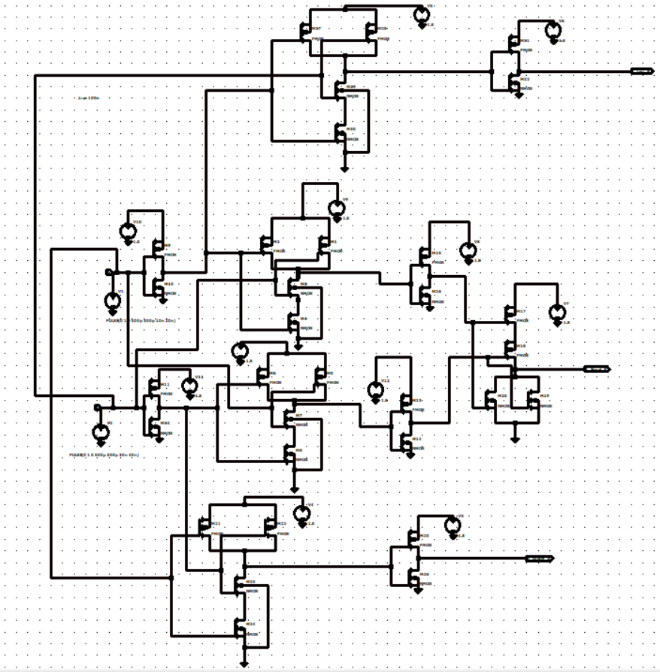
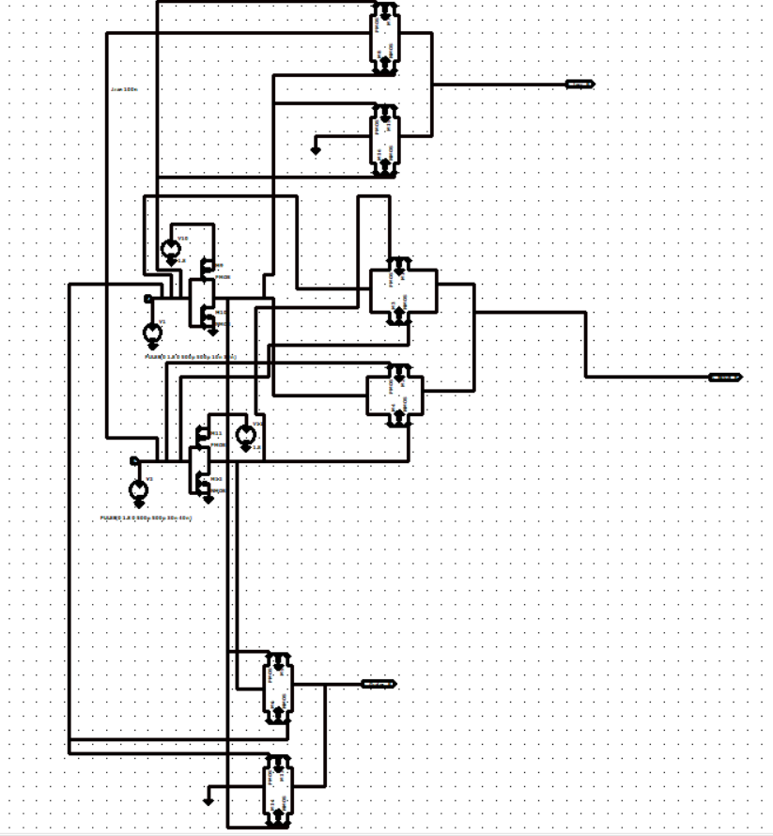
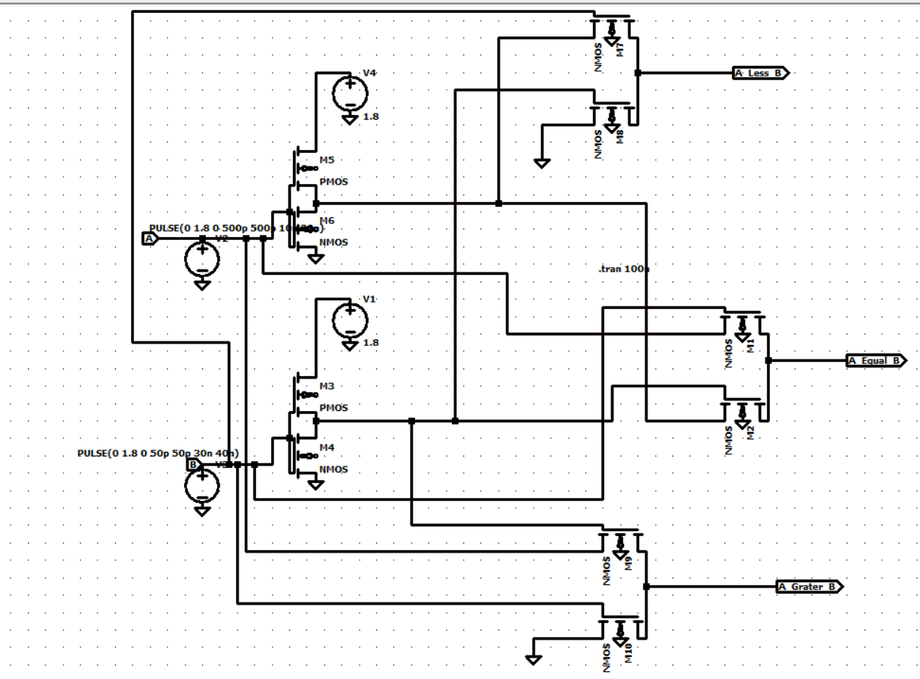
CIRCUIT DESIGN COMPARE IN VARIOUS TECHNIQUE
Static CMOS (26T)
Transmission Gate (16T)
Pass Transistor (12T)
PROS:
PROS:
PROS:
Full voltage swing (VDD to GND), high noise margin.
Full signal restoration, lower delay than CMOS.
Reduced transistor count (12T-14T).
CONS:
CONS:
CONS:
Excessive transistor count (26T), high parasitic capacitance.
Requires complementary control signals (A, A'), high routing.
Threshold voltage drop (Vth loss), signal degradation.
Fig 01: Static CMOS
Fig 02: TG CMOS
Fig 03: PTL CMOS
11

Slide 13
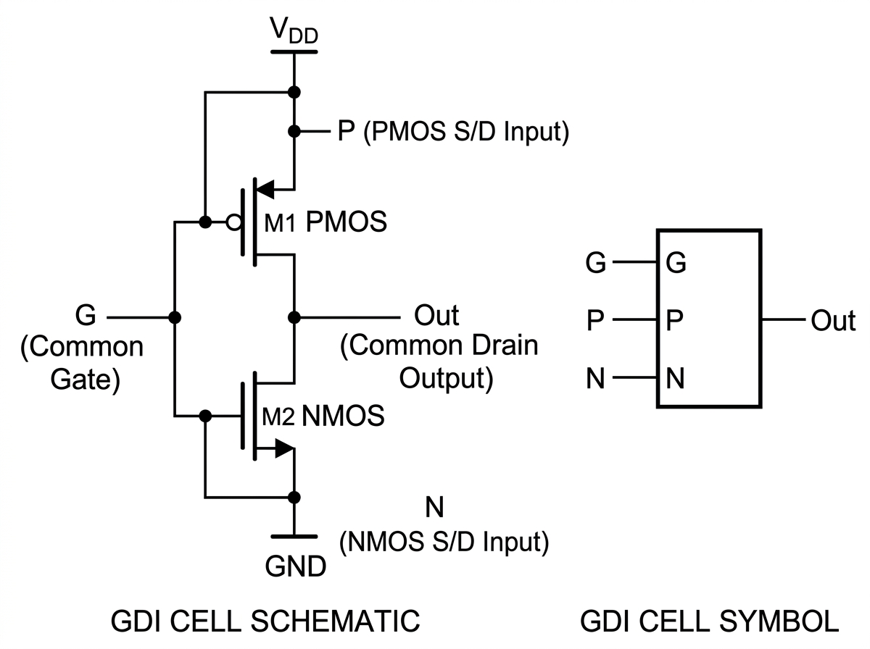
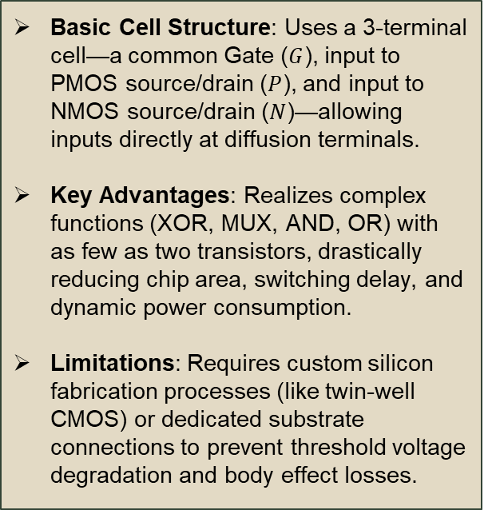
GATE DIFFUSION INPUT (GDI) TECHNIQUE
Basic Cell Structure: Uses a 3-terminal cell—a common Gate ($G$), input to PMOS source/drain ($P$), and input to NMOS source/drain ($N$)—allowing inputs directly at diffusion terminals.
Key Advantages: Realizes complex functions (XOR, MUX, AND, OR) with as few as two transistors, drastically reducing chip area, switching delay, and dynamic power consumption.
Limitations: Requires custom silicon fabrication processes (like twin-well CMOS) or dedicated substrate connections to prevent threshold voltage degradation and body effect losses.
Fig 04: GDI CELL SCHEMATIC
12

Slide 14
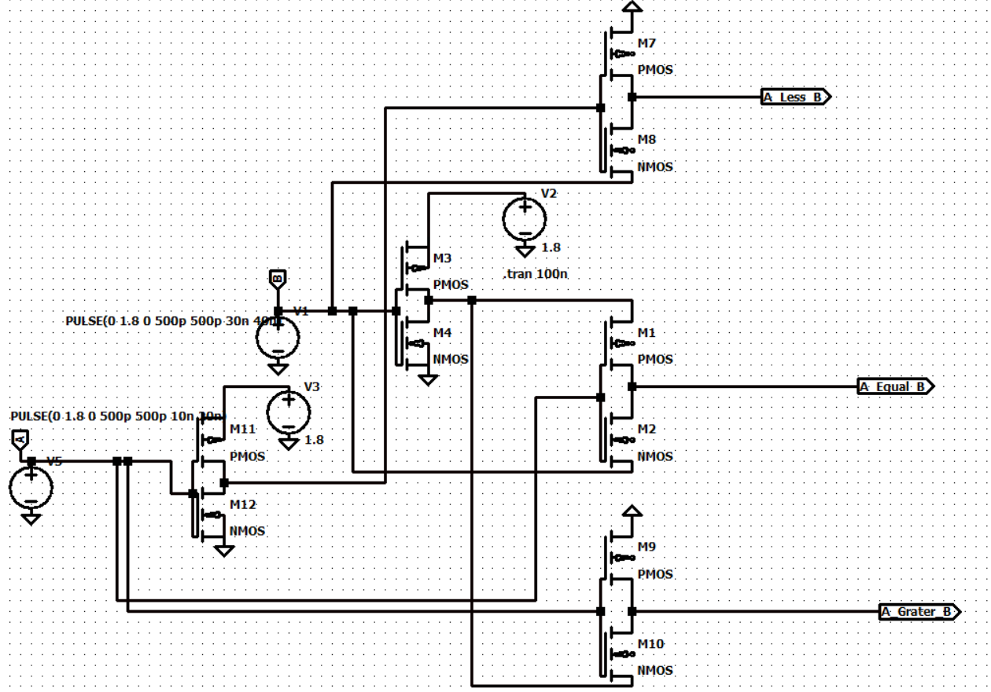
PROPOSED 10 TRANSISTOR GDI MAGNITUDE COMPARATOR
Proposed 10 Transistor Schematic
Fig 05: Proposed 10 Transistor Schematic
13

Slide 15
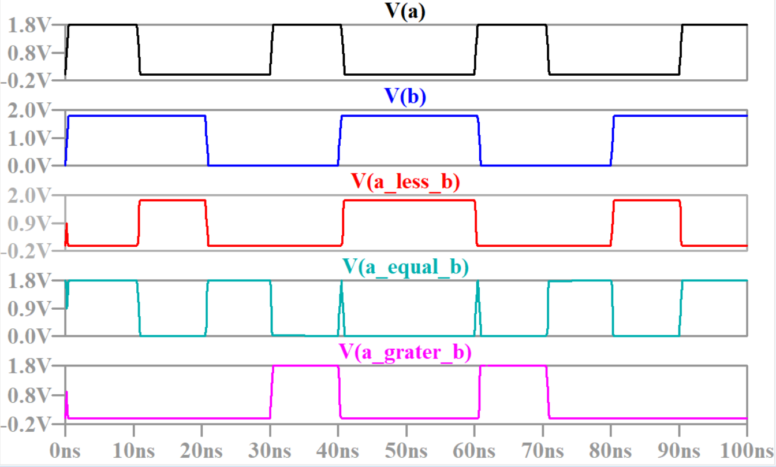
SIMULATION RESULTS
Static CMOS Paper (2017) :
  Propagation Delay : 49.38 ns
  Average Power Dicipiation : 174.352 pW
  PDP: 0.0086f
MTCMOS paper(2019):
  Propagation Delay : 330.61 ps
  Average Power Dicipiation : 48.12 pW
  PDP: 0.0000159f
Static,Pass,TG paper (2020):
  Propagation Delay : 0.192 ns
  Average Power Dicipiation : 7.792 uW
  PDP: 1.496f
Fig 06 : Output Waveshape
14

Slide 16
SIMULATION RESULTS
6T MUX Adder Comparator(2025):
  Propagation Delay : 5.5 ps
  Average Power Dicipiation : 7.3uW
  PDP: 0.04f
My Propose Design:
  Propagation Delay : 336 ps
  Average Power Dicipiation : 34.18 pW
  PDP: 0.0000114f
Fig 07 : Output Waveshape
15

Slide 17
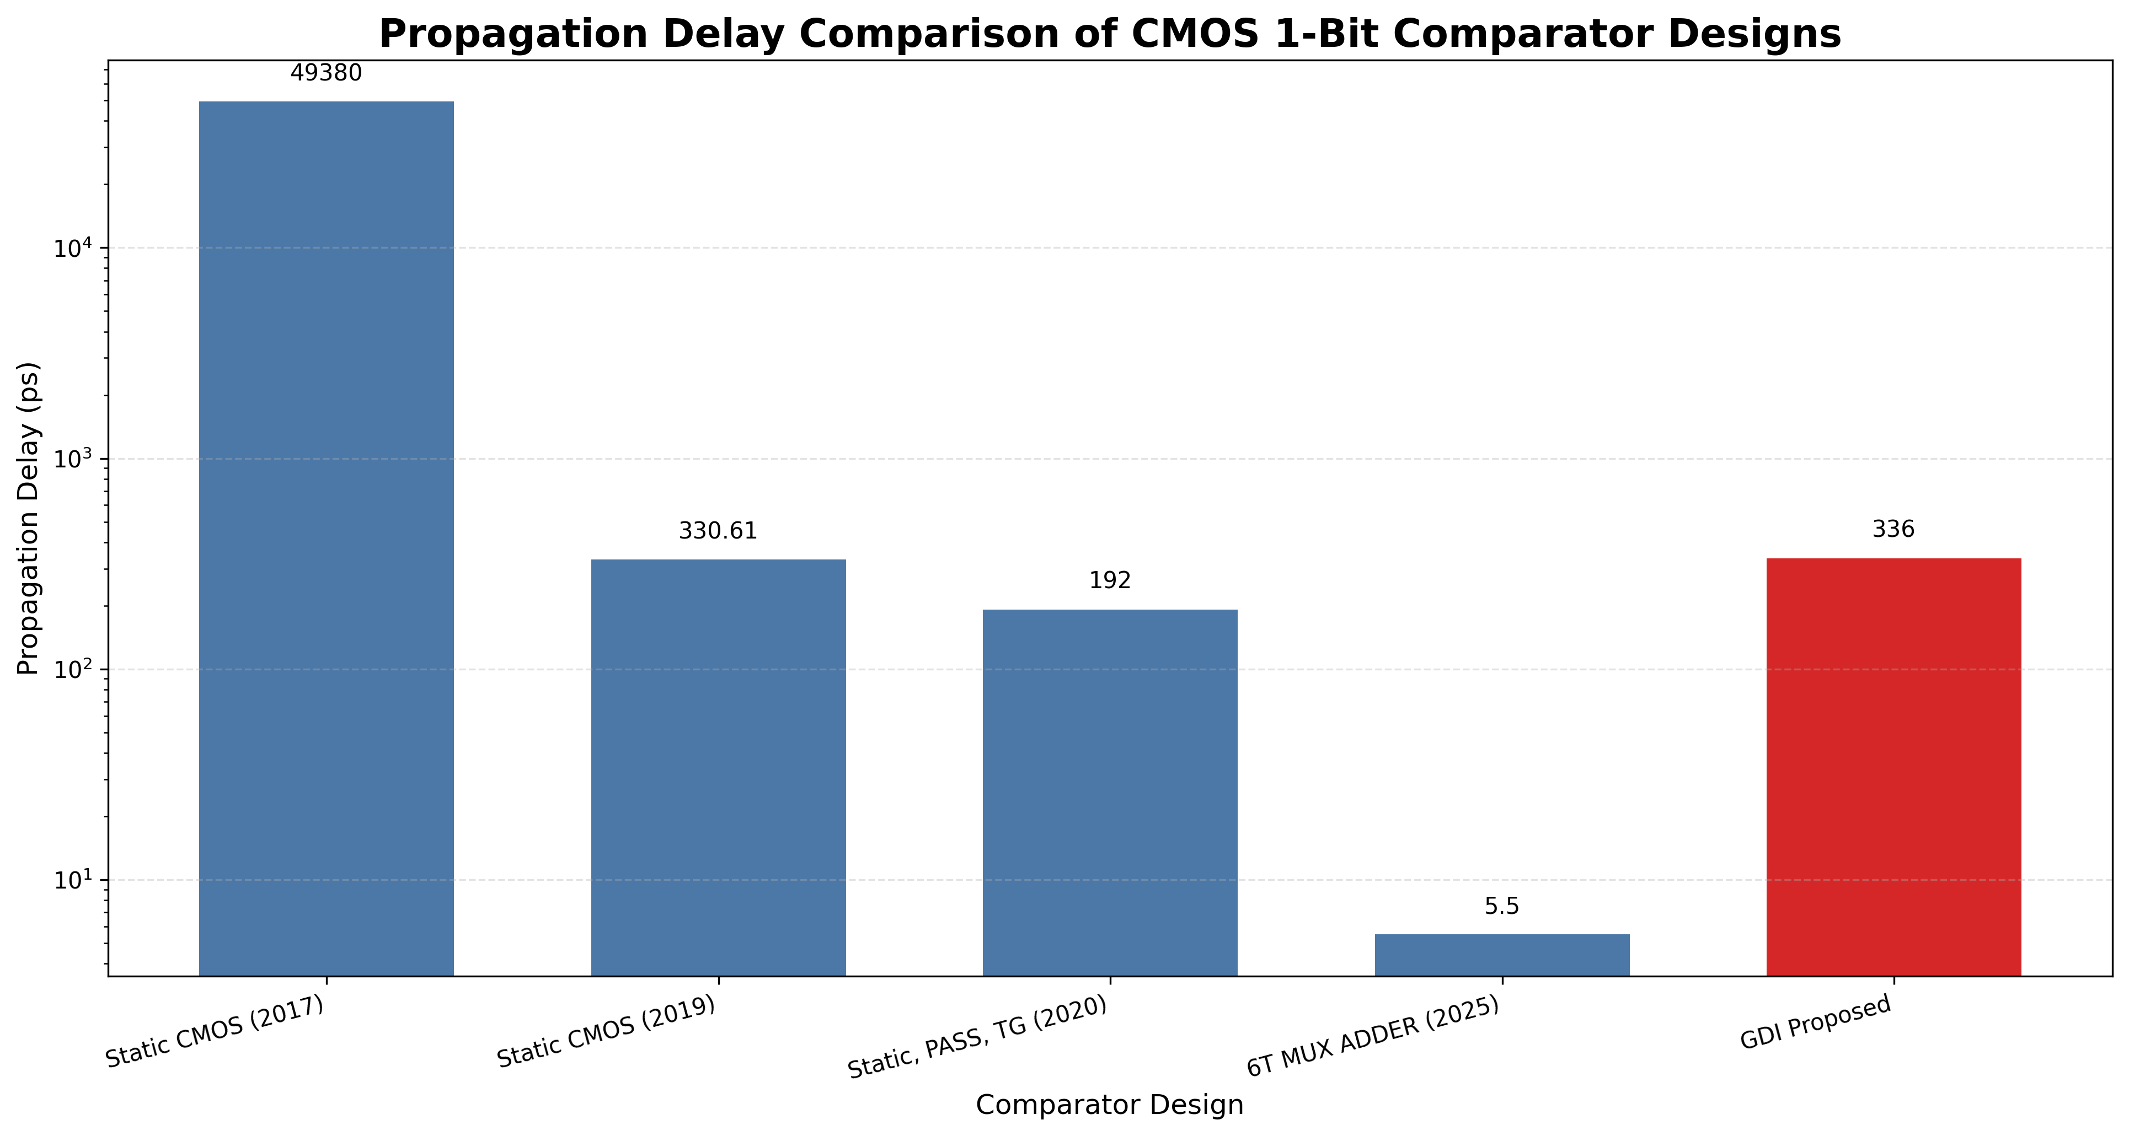
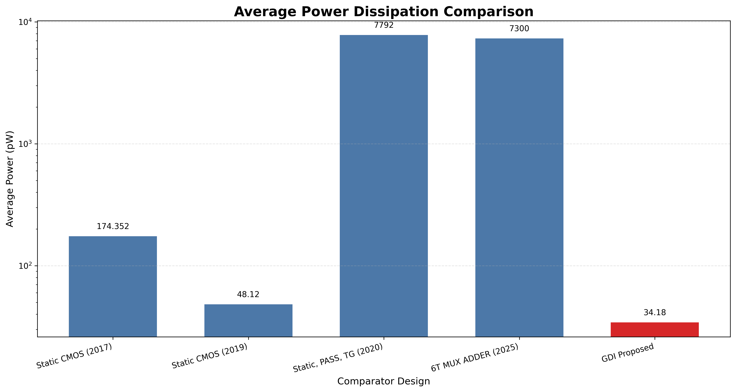
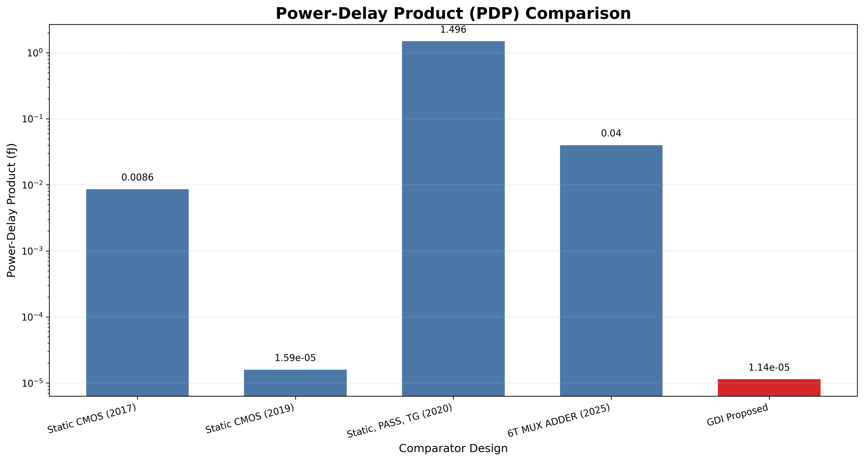
PERFORMANCE COMPARISON
Propagation Delay Bar Chart
Average Power Dissipation Bar Chart
PDP (Energy per Operation) Bar Chart
Fig 08 : Propagation Delay
Fig 09 : Average Power Dissipation
Fig 10: Product Delay Propagation
16

Slide 18
KEY FINDINGS
GDI Technique demonstrate:
Its low power consumption.
Provides short propagation delay.
Requires fewer transistors.
CMOS still viable for cost-sensitive applications
17

Slide 19
CONCLUSION
CMOS faces scalability and performance limitations
GDI technique addresses these with superior design
For future VLSI design, GDI technique offers better performance and efficiency
LTspice simulations confirm performance gains in GDI based designs
18

Slide 20
Future Work
Study GDI Technique under varied temperatures and voltages
Analyze integration into larger digital blocks (e.g., ALUs)
Explore hybrid logic families for ultra-low power designs
Investigate real-time implementations using FPGA or ASIC platforms
Evaluate GDI performance in logic-intensive circuits like full adders or multiplexers
Explore noise immunity and signal integrity analysis in GDI Technique
Extend simulations to beyond to analyze scalability
19

Slide 21
REFERENCES
[1] A. Kumar and M. Kumar, “Improved Design of CMOS 1-Bit Comparator with Stacking Technique,” International Journal of Current Engineering and Technology, Vol. 7, no. 3, pp. 1044–1047, 2017.
[2] D. Tailor, T. Sharma, and M. Kumar, “Design of CMOS Based 1-bit Comparator with MTCMOS and Forced Stack Technique in 180µm Technology,” in Proc. 2019 IEEE International Conference on Signal Processing and Communication (ICSC), NOIDA, India, pp. 330–334, 2019.
[3] S. Lubaba, M. S. Islam, K. M. Faisal, and M. Hasan, “Design of a Two-Bit Magnitude Comparator Based on Pass Transistor, Transmission Gate and Conventional Static CMOS Logic,” in Proc. 2020 IEEE Region 10 Symposium (TENSYMP), Dhaka, Bangladesh, pp. 1114–1117, 2020.
[4] Y. Sharma, B. S. Premananda, D. Raj, and K. Pandey, “Design and Analysis of a 1-bit Comparator for Low Power VLSI Systems,” in Proc. 2025 Third International Conference on Networks, Multimedia and Information Technology (NMITCON), Bengaluru, India, pp. 1–6, 2025.
20

Slide 22
THANK
YOU

